Slide 1
Interaction Design
Gathering and Analysing Data

Slide 2
Interaction Design
Iterative user centered design and development
Requirements gathering
Quick design
Build prototype
Evaluate and reﬁne requirements
Engineer product

Slide 3
Data Gathering and Analysing
Data gathering
Observation
Interviews
Focus groups
Card sorting
Questionnaires
Studying documentation
Scenarios / Use cases
Researching similar products
Web analytics
Data analysis & interpretation
Quantitative data analysis
Qualitative data anlysis

Slide 4
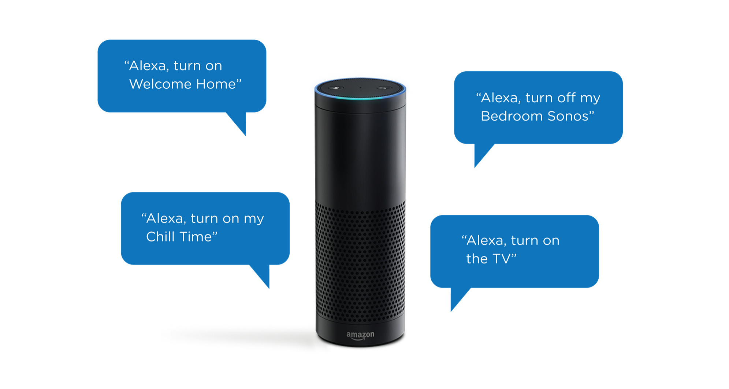
Case Study: Amazon Alexa
These four slides are based on: Amazon Alexa talk by Dr Craig Saunders (31 January 2018)

Slide 5
Alexa: Single vs. Multiple Answers
Should Alexa give one single answer to a user’s question or multiple answers?
How does Amazon make such a decision?

Slide 6
Alexa: Asking Questions
Should Alexa ask you a question without you calling her to action by saying ‘Hey Alexa’?
How does Amazon know that?

Slide 7
Alexa: Sensitive Topics
Does Alexa know which topics are sensitive and should not be talked about / discussed?
How does Amazon know that?

Slide 8

Gathering Data

Slide 9
Gathering Data
To collect sufficient, relevant, and appropriate data
to produce a stable set of requirements
To collect data about users, their tasks, the context of use, and the rationale

Slide 10
Data Collection Techniques
Observation
Interviews
Focus groups
Card sorting
Questionnaires
Studying documentation
Scenarios / Use cases
Researching similar products
Web analytics

Slide 11
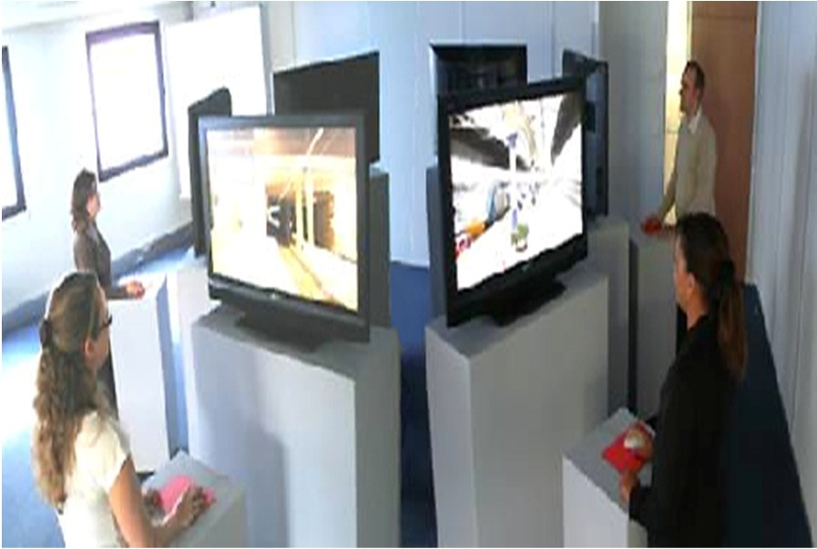
Observation (1)
Observation in the field (ethnography)
⊕: Realistic settings/ activities
⊗: Difficult to set up
⊗: Complex observation may intrude upon the user:
May effect their performance
May skew the data
⊗: Problems of privacy/ reliability
Observation in the lab
⊕: Less intrusion
⊗: But not realistic setting/ activities

Slide 12
Observation (2)
Direct observation: Concurrent protocol
The users say what they are doing and why, whilst they are performing the task
⊕: good for understanding the nature and context of the task
⊗: too much data, time consuming
Indirect observation: Retrospective protocol
The users explain what they did and why, after they have finished the event
e.g. observing the users through records of their activity such as logs

Slide 13

Interviews (1)
An interviewer asks an interviewee a set of questions
May be structured in different ways:
Unstructured interviews (open questions)
⊕: rich data, ⊗: too much data, off target, long
Structured interviews (closed questions)
⊕: easy data collection, ⊗: rigid
Semi-structured interviews (open & closed questions)
⊕: rich targeted data

Slide 14
Interviews (2)
Attempt to identify user’s / interviewee’s subjective opinions
⊕: forum for talking to people
⊕: good for exploring issues
Avoid:
Long questions
Compound sentences - split them into two
Jargon and language that the interviewee may not understand
Leading questions that make assumptions e.g.. why do you like …?
Unconscious biases e.g.. gender stereotypes

Slide 15

Interviews (3): Enriching the Process
Props - devices for prompting interviewee, e.g. use a prototype, scenario
www.id-book.com

Slide 16

Focus Groups
Interviewing people in groups
Used to identify conflicts in terminology or expectations from different groups
Important: select participants to represent well the target users

Slide 17
Card Sorting (1)
Applied to a wide variety of activities involving the grouping and/or naming of objects or concepts
The sorting process is performed by potential users of an interactive solution
It provides:
Terminology (what people call things)
Relationships (proximity, similarity)
Categories (groups and their names)
https://www.interaction-design.org/literature/book/the-encyclopedia-of-human-computer-interaction-2nd-ed/card-sorting

Slide 18
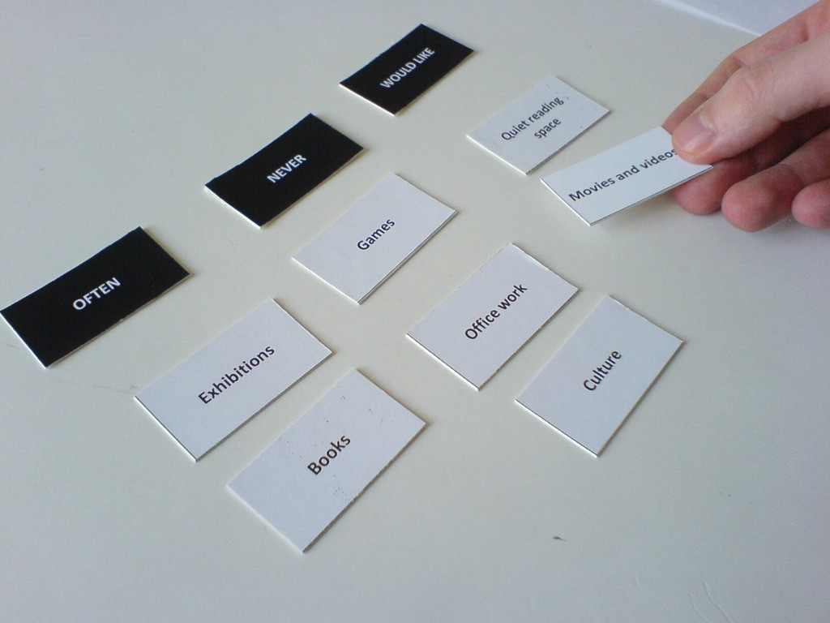
Card Sorting (2)
Participant is given a set of paper cards
Each card has some aspect of the work or environment on it
Participant is asked to sort the cards into groups
Typically groups of similar items
⊕: Can get an idea of participant’s perceptions of the nature of the items and activities

Slide 19
Card Sorting (3)
Open Card Sorting: Participants are given cards showing content with no pre-established groupings
They are asked to sort cards into groups that they feel are appropriate and then describe each group
Closed Card Sorting: Participants are given cards showing content with an established initial set of primary groups
Participants are asked to place cards into these pre-established primary groups
Hybrid Card Sorting: Some combination of the two

Slide 20
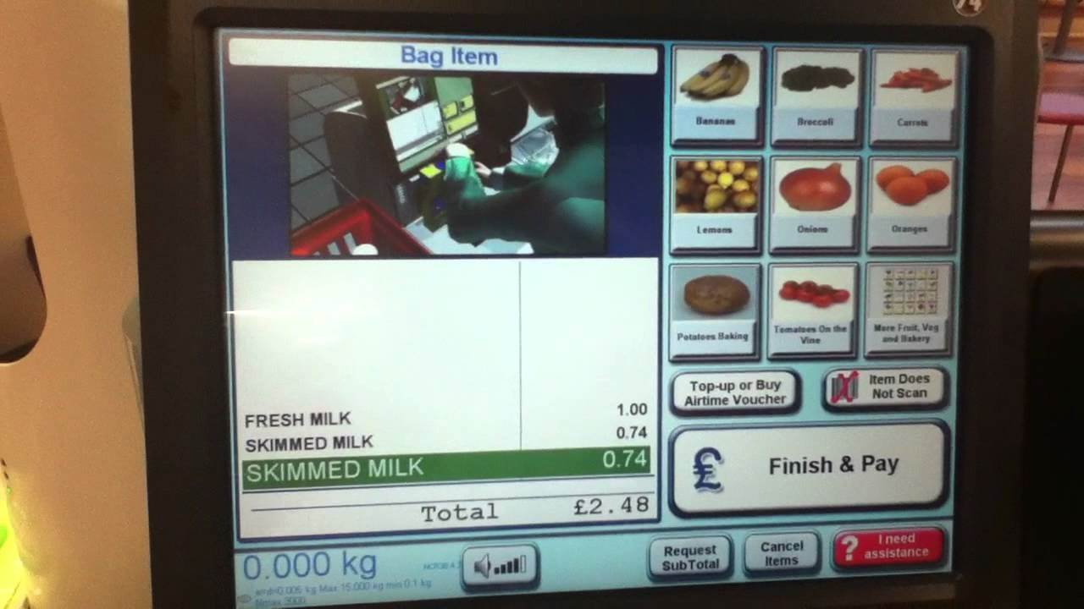
Case Study: Open Card Sorting
Your team is responsible for the information architecture of the self-checkout counters of a large supermarket chain
There have been some complaints that customers are spending a long time at these counters and are frustrated by how the categories are organized
https://www.interaction-design.org/literature/book/the-encyclopedia-of-human-computer-interaction-2nd-ed/card-sorting

Slide 21
Case Study: Open Card Sorting
You are asked to consider how you might organize these yourself
Use the items listed below and group them into four groups based on
similarity
Give a name/title for each group
apples
oranges
strawberries
bananas
peaches
plums
tomatoes
pears
grapes
cherries
?

Slide 22
Open Card Sorting: Solution

Slide 23
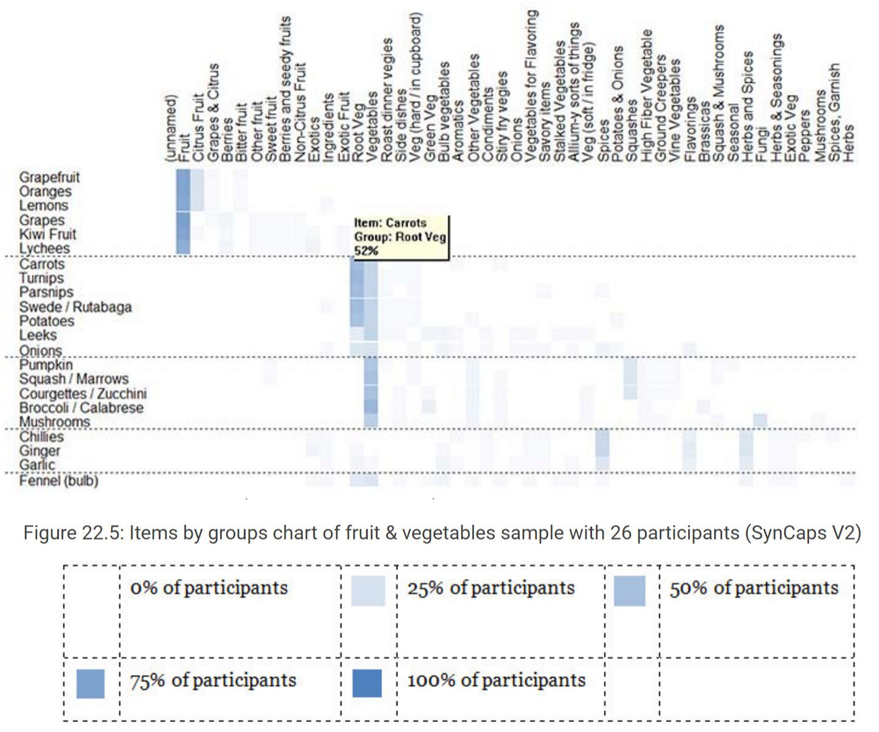
Card Sorting: Example
https://www.interaction-design.org/literature/book/the-encyclopedia-of-human-computer-interaction-2nd-ed/card-sorting

Slide 24

Questionnaires (1)
A series of questions designed to elicit specific information
Good for getting answers to specific questions from a large, dispersed group of people
Can provide quantitative or qualitative data
Often used in conjunction with other techniques

Slide 25
Questionnaires (2)
Open questions – the respondent is free to write their answers in any way they see fit
Closed questions – the respondent selects an answer from a set of presented possibilities
Several kinds of scale from which participants can choose their response including:
Simple checklist – simple responses such as ‘yes’, ‘no’, or ‘don’t know’ are provided
Multi-point rating scale – a number of points on a scale are provided which give a range of responses
Ranked order – respondent specifies their preference for items in a list

Slide 26
Questionnaires (3)
Questionnaires: Multi-point ranking
E.g. a variation of the Likert scale
Rating scale
(6-point)
Strongly agree
Strongly disagree
Likert scale
(6-point)
Strongly | agree | Slightly | Neutral | Slightly | Disagree | Strongly
agree |  | agree |  | disagree |  | disagree

Slide 27
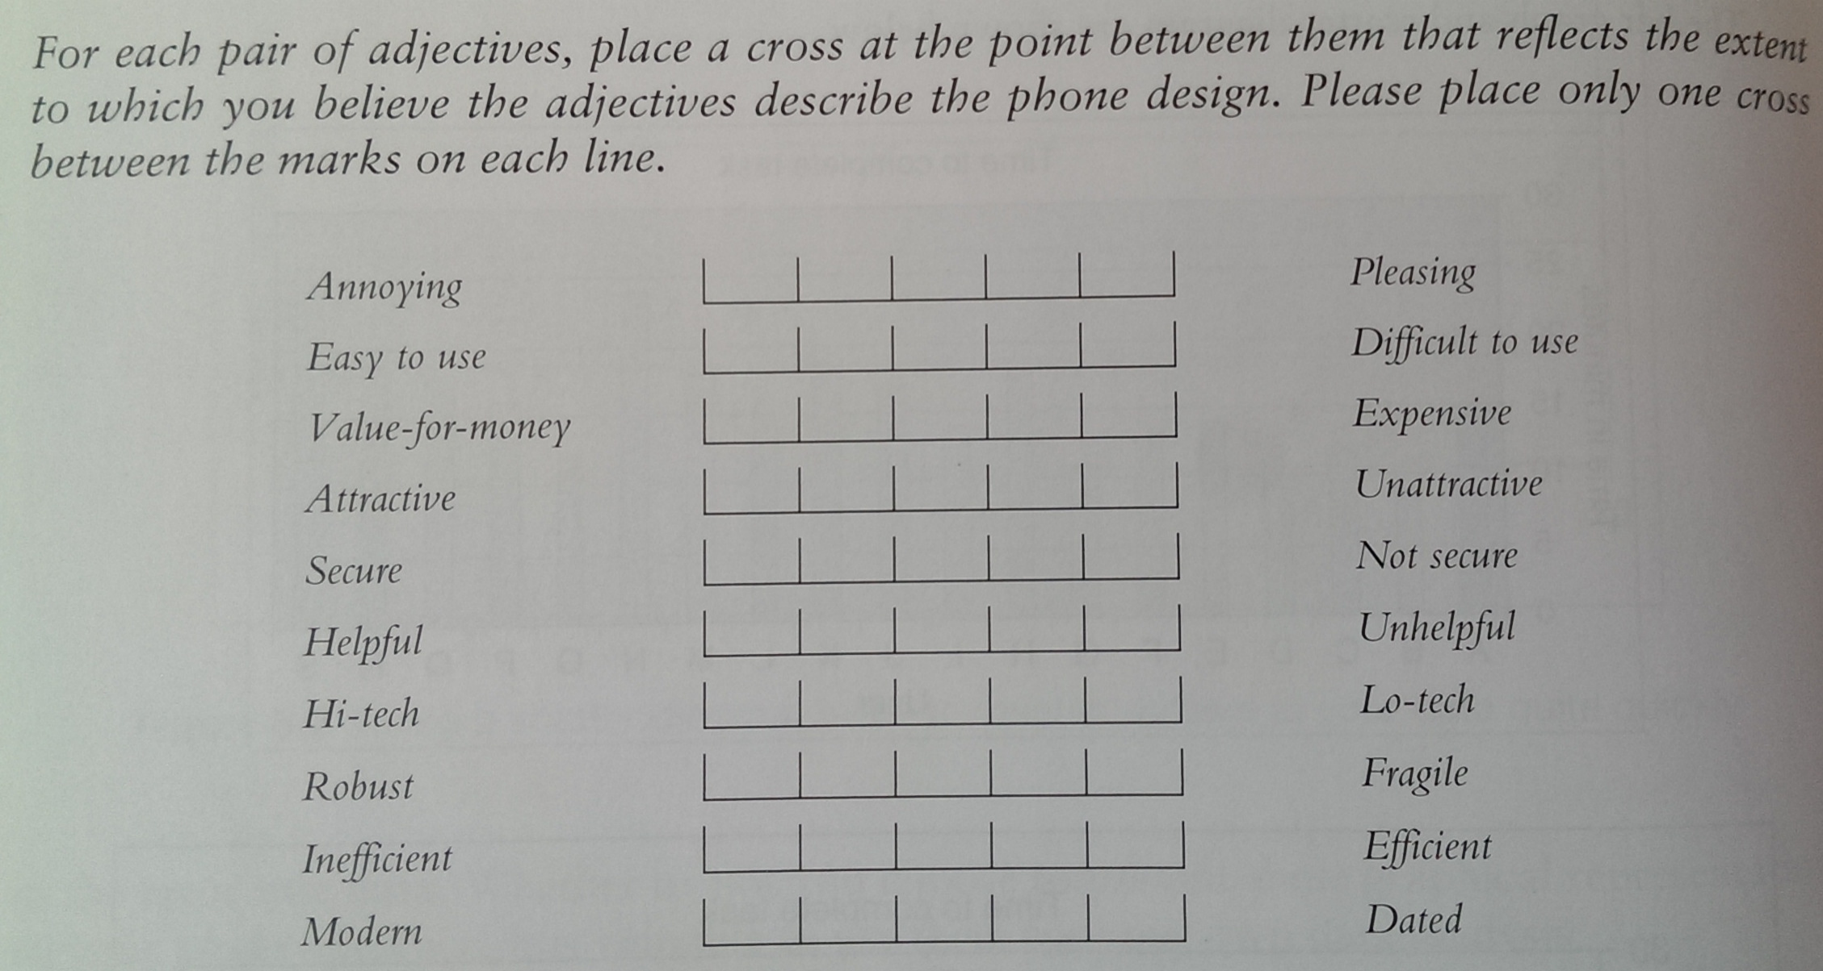
Questionnaires: Example
Questionnaire to evaluate two different phone designs

Slide 28
Questionnaires: Things to Remember (1)
The impact of a question can be influenced by question order
You may need different versions of the questionnaire for different populations
Provide clear instructions on how to complete the questionnaire
Avoid very long questionnaires
Decide on whether phrases will all be positive, all negative or mixed

Slide 29
Questionnaires: Things to Remember (2)
Make sure purpose of study is clear
Promise anonymity
Ensure questionnaire is well designed
Offer a short version for those who do not have time to complete a long questionnaire
Provide an incentive
40% response rate is good, 20% is often acceptable

Slide 30
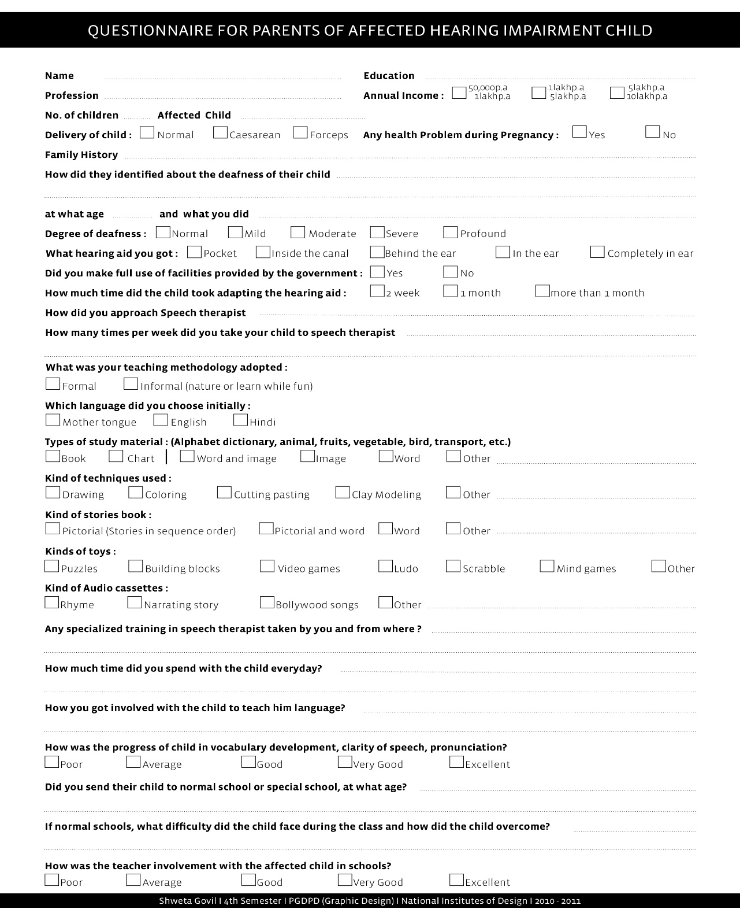
Questionnaires: Example (2)
Source: https://shwetakijabani.files.wordpress.com/2010/02/final-q1.jpg

Slide 31

Studying Documentation
Procedures and rules are often written down in manuals
Good source of data about the steps involved in an activity
and regulations governing a task
Good for understanding legislation, and getting background information
No stakeholder time
a limiting factor on the other techniques
Not to be used in isolation
Overall:
⊕: availability, accessibility
⊗: idealized reports, outdated

Slide 32
Researching Similar Products
⊕ Helps to prompt requirements
⊕ Helps to generate alternative designs
⊗ May inhibit creativity

Slide 33
Web Analytics
A system of tools and techniques for optimizing web usage by:
Measuring
Collecting
Analysing
Reporting web data
Typically focus on the number of web visitors and page views

Slide 34
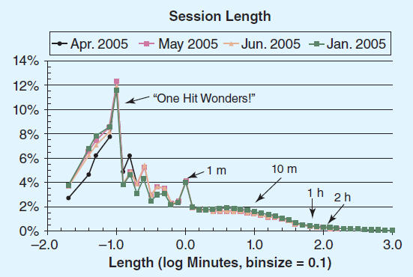
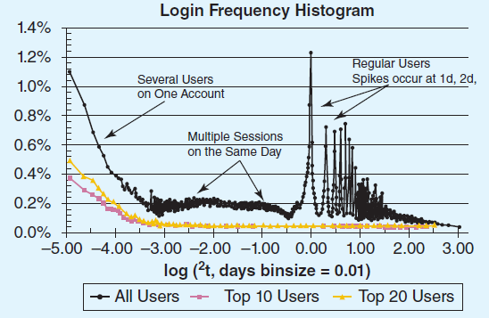
Web Analytics: Example
www.id-book.com

Slide 35
Choosing Between Techniques
The choice of technique depends on:
Amount of time, level of detail and risk associated with the findings
Knowledge the analyst requires
The choice is also affected by the kind of task studied:
Sequential steps or overlapping series of subtasks?
High or low, complex or simple information?
Task for a layman or a skilled practitioner?

Slide 36
Basic Guidelines (1)
Focus on identifying the stakeholders’ needs
Involve all the stakeholder groups
Involve more than one representative from each stakeholder group
Triangulation
Use a combination of data gathering techniques
Collect more than one type of data

Slide 37
Basic Guidelines (2)
Consider carefully how to record the data
You will need to compromise on the data you collect and the analysis to be done
Support the process with prototypes and task descriptions
Balance functional and non-functional requirements

Slide 38
Data Analysis & Interpretation

Slide 39
Data Analysis & Interpretation
Helps you interpret and present your findings in appropriate ways
Qualitative and quantitative data analysis
To analyse data gathered from:
Questionnaires
Interviews
Observation studies
…

Slide 40
Quantitative vs. Qualitative Data
Quantitative analysis
numerical methods to ascertain size, magnitude, amount
Qualitative analysis
expresses the nature of elements
represented as themes, patterns, stories
difficult to measure sensibly as numbers
e.g. count number of words to measure dissatisfaction

Slide 41
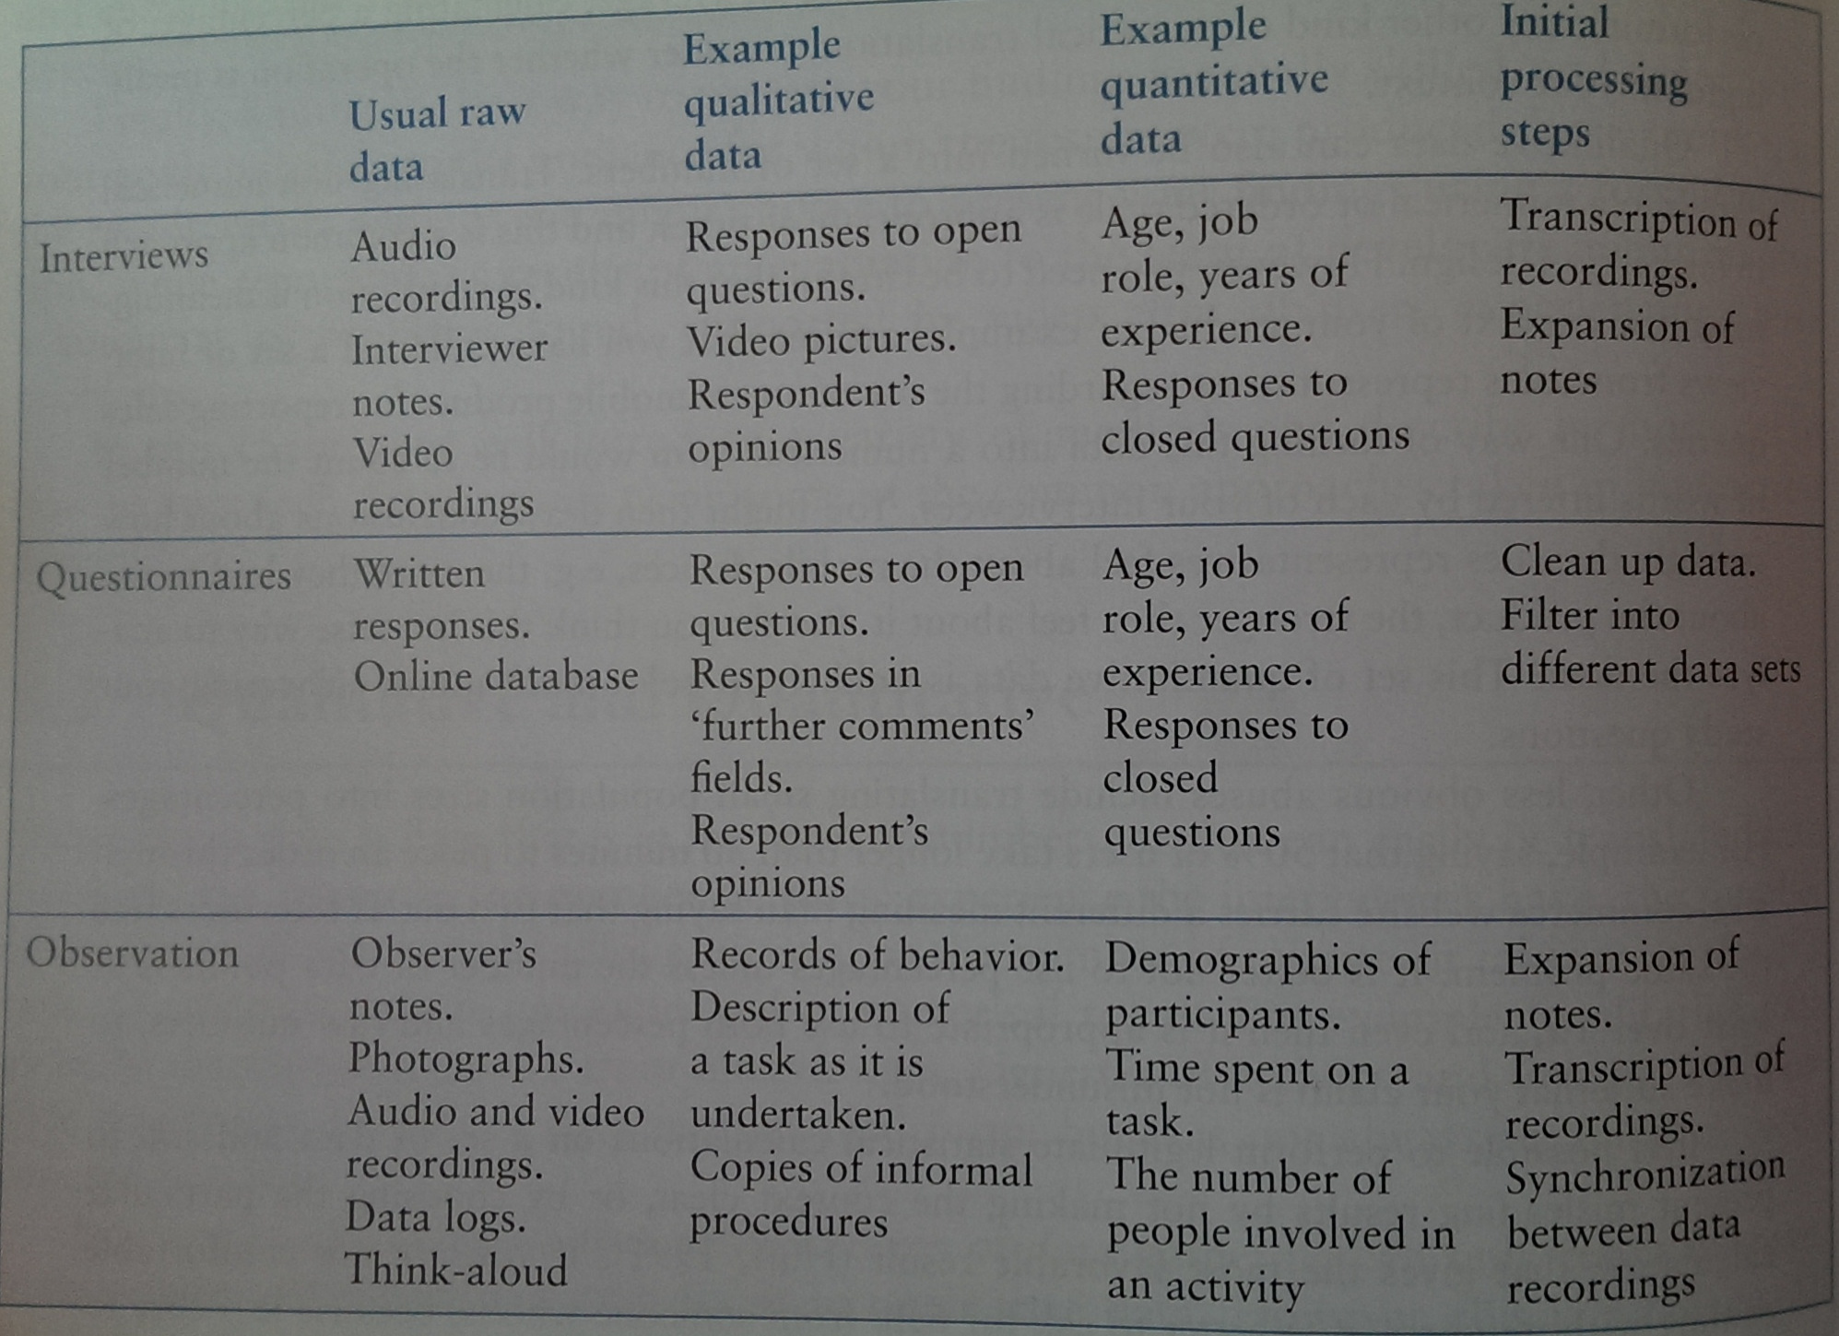
Initial Processing

Slide 42
Initial Processing: Example
Questionnaire to evaluate two different phone designs

Slide 43
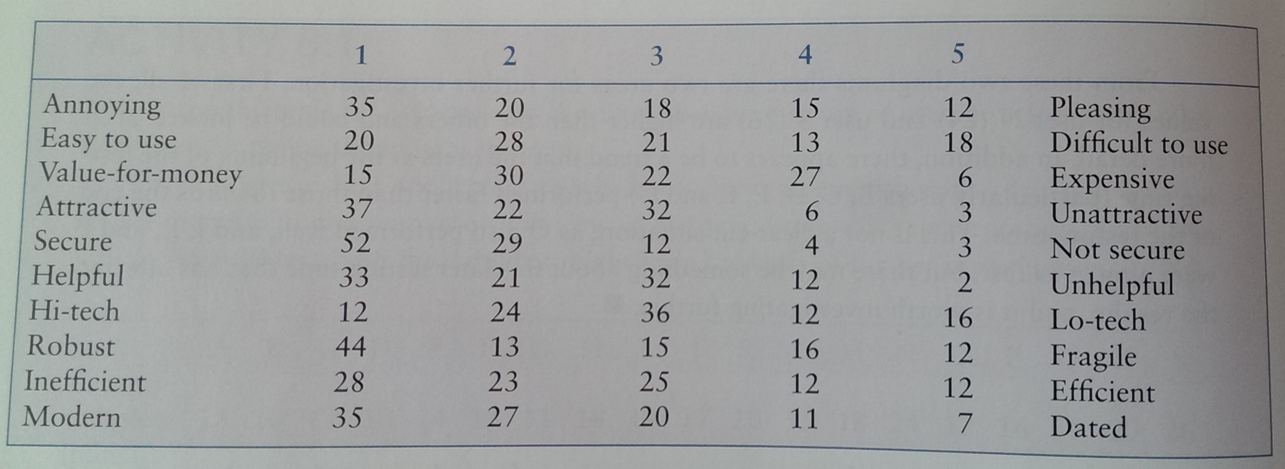
Initial Processing: Example
Questionnaire to evaluate two different phone designs
100 respondents for the evaluation of phone 1

Slide 44
Simple Quantitative Analysis
Averages
Mean: add up values and divide by number of data points
Median: middle value of data when ranked
Mode: figure that appears most often in the data
Percentages
Graphical representations give overview of data
Important: Be careful not to mislead with numbers!

Slide 45
Quantitative Analysis: Example (1)
Results:
Experience of users
Internet use
< once a day once a day once a week
2 or 3 times a week once a month

Slide 46
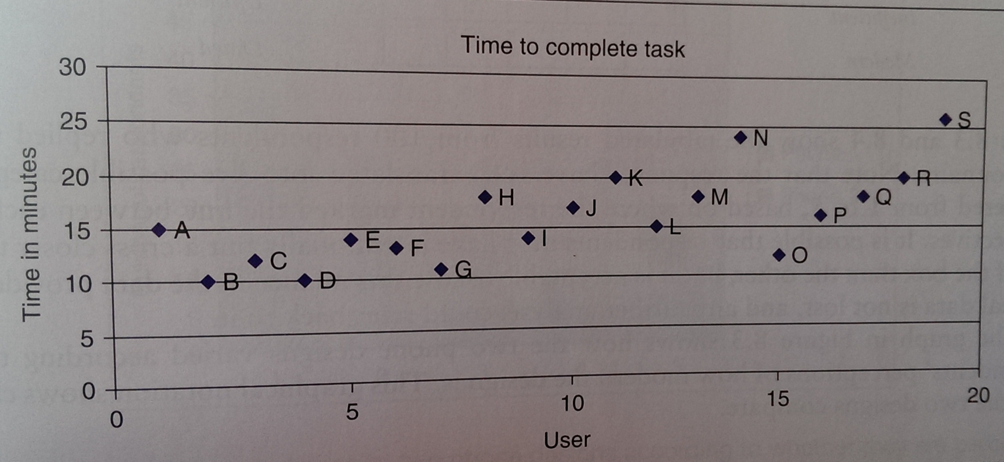
Quantitative Analysis: Example (2)
Results:
Time to complete the task

Slide 47
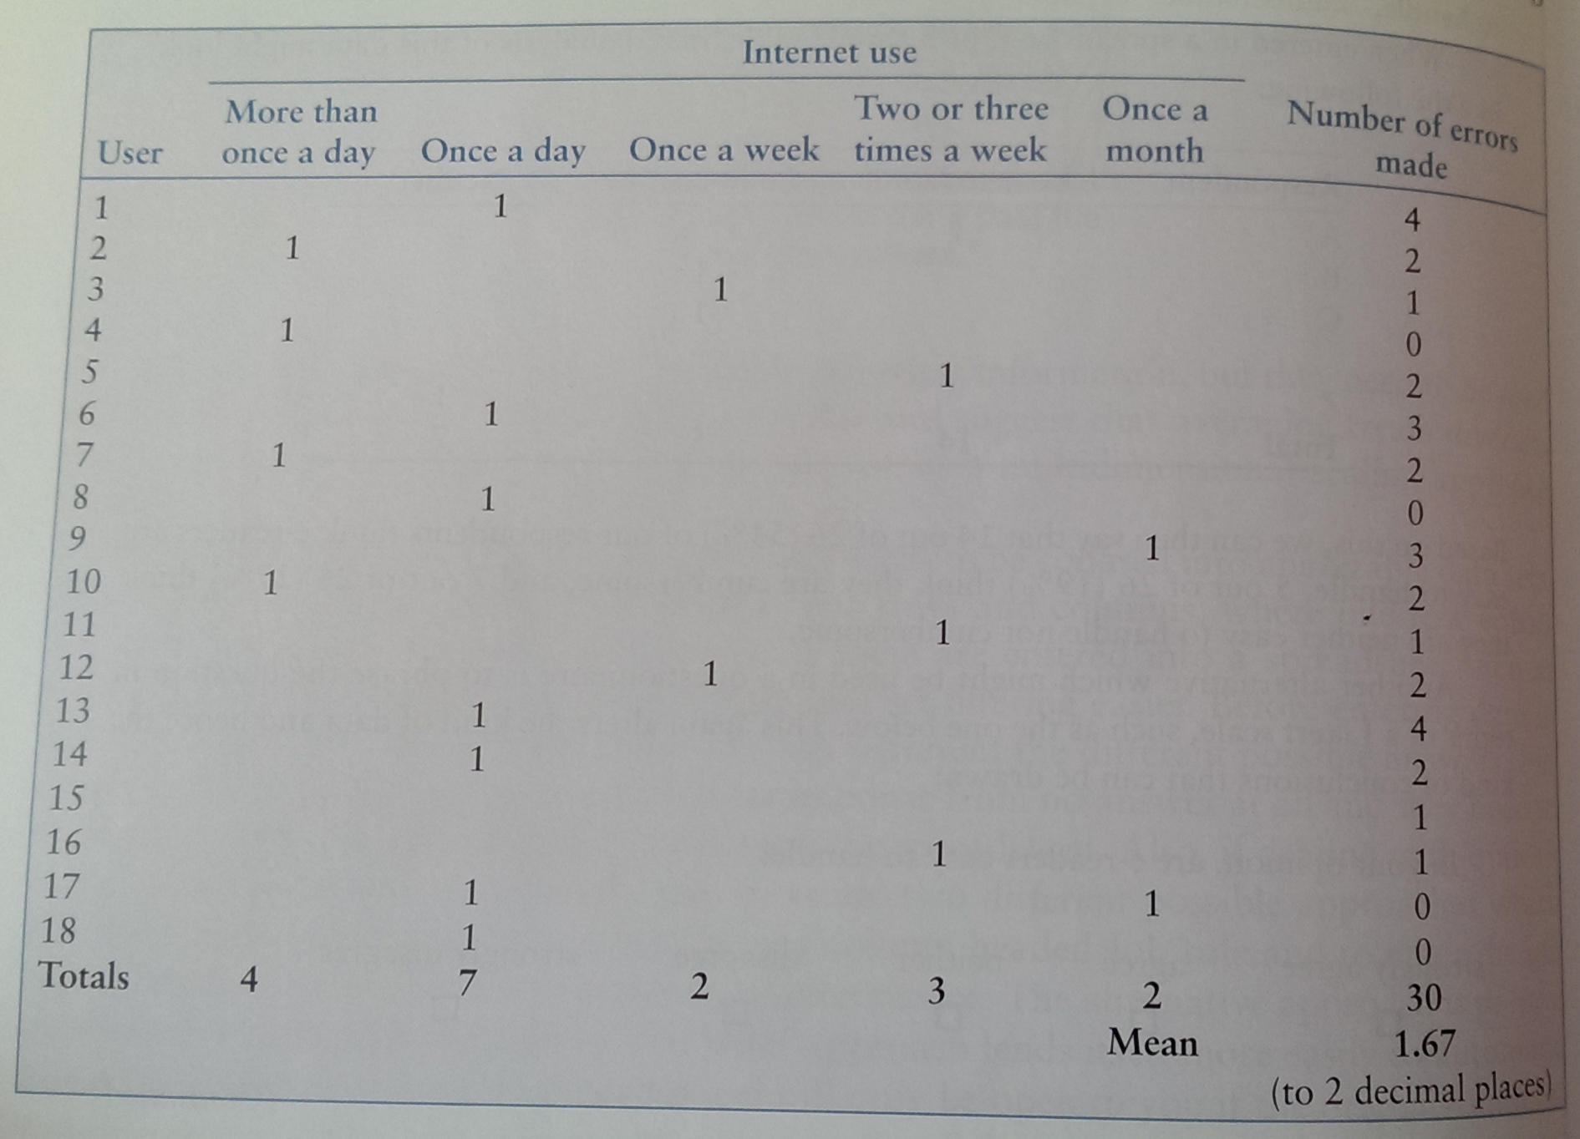
Quantitative Analysis: Example (3)
An evaluation study of a document sharing application
The experience of the users and the number of errors made while trying to complete the controlled task

Slide 48
Quantitative Analysis : Card Sorting
Need to find commonalities of how people grouped the cards
Which items were grouped together most often?
Small projects
Just looking at the piles for patterns could be sufficient
Larger projects
Will require some form of analysis, ranging from simple tabulation through to cluster analysis

Slide 49
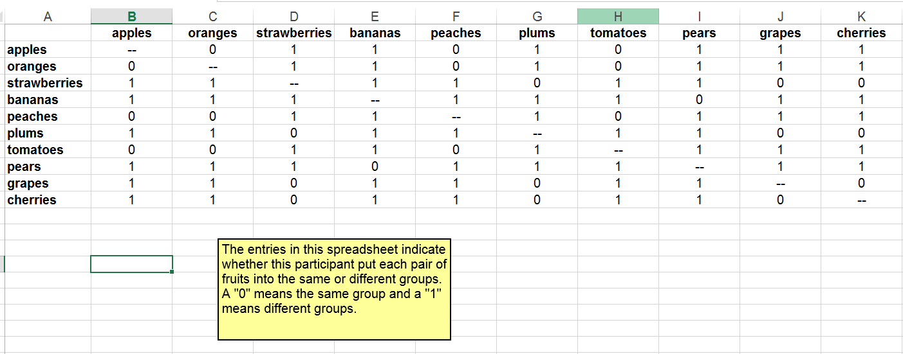
Card Sorting: Example of Analysis
Fruits example
Results from 1 participant

Slide 50
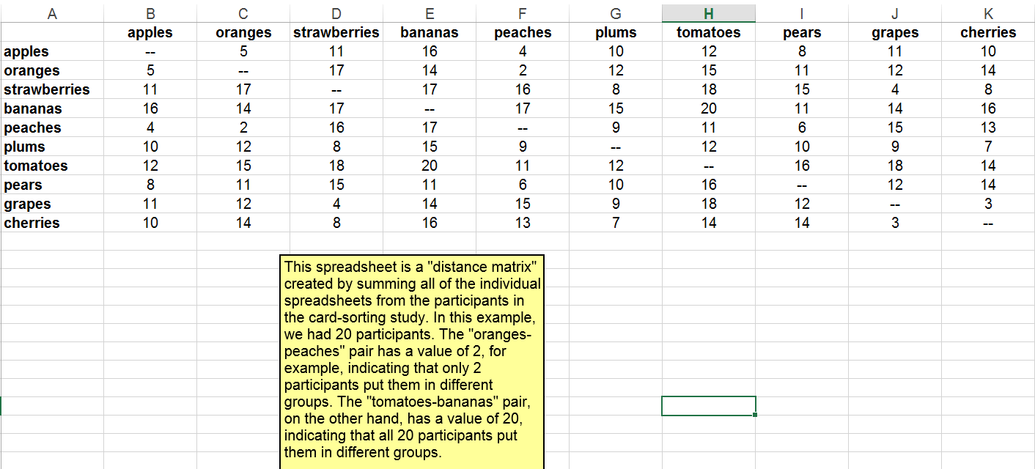
Card Sorting: Example of Analysis
Fruits example
Distance matrix: results from 20 participants

Slide 51
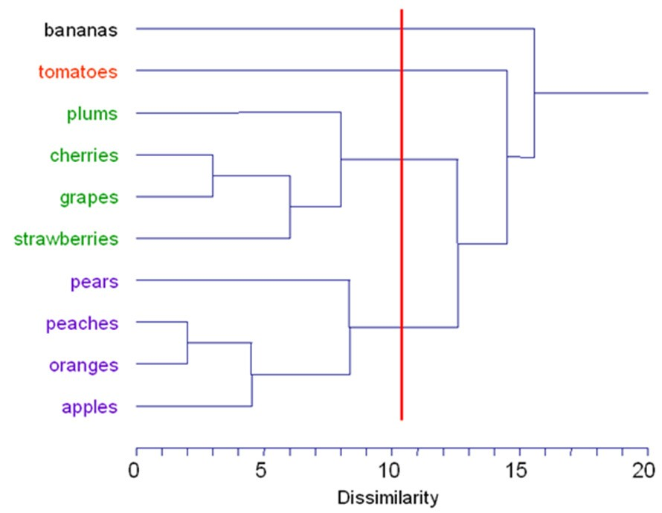
Card Sorting: Example of Analysis
Fruits example
Results of hierarchical cluster analysis of the sample data in
the form of dendogram
a tree diagram showing taxonomic relationships
Further reading: http://www.econ.upf.edu/~michael/stanford/maeb7.pdf

Slide 52
Card Sorting : Cluster Analysis
Measure: Similarity rating
Every time two cards are in the same pile you assign them 1 point
Similarity rating = add up all of the times that two cards appear together and divide by the number of groups

Slide 53
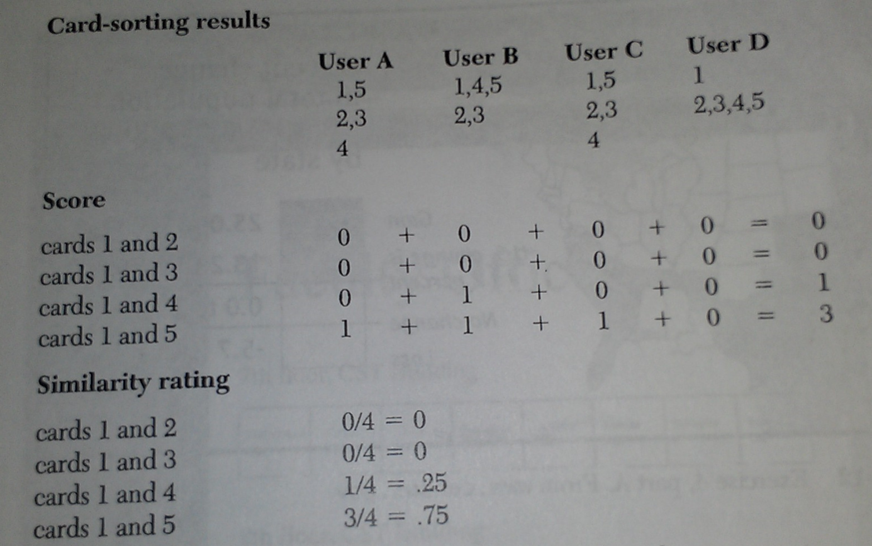
Cluster Analysis: Example
Calculate the similarity rating

Slide 54
Qualitative Data Analysis
Recurring patterns or themes
Emergent from data
Dependent on observation framework if used
Categorizing data
Categorization scheme may be emergent or pre-specified
Looking for critical incidents
Helps to focus in on key events

Slide 55
Qualitative Data Analysis
Theoretical Frameworks
Basing data analysis around theoretical frameworks provides further insight
Such frameworks are:
Grounded Theory
Distributed Cognition
Activity Theory
Thematic Analysis

Slide 56
Tools to Support Data Analysis
Spreadsheet – simple to use, basic graphs
Statistical packages
e.g. SPSS
Qualitative data analysis tools
Categorization and theme-based analysis
Quantitative analysis of rich text-based or multimedia data
Example software for qualitative data analysis:
Nvivo
Atlas.ti
CAQDAS Networking Project, based at the University of Surrey http://www.surrey.ac.uk/sociology/research/researchcentres/caqdas/

Slide 57
Presenting the Findings
The best way to present your findings depends on
the audience
the purpose
the data gathering and analysis undertaken
Use graphical representations as needed
Important: Only make claims that your data can support !

Slide 58
Summary
Data collection is critical to successful design
The data analysis that can be done depends on the data gathering that was done
Choose your data collection techniques wisely
Kinds of data collected
Time to collect and interpret data
Interference with activity being studied
Presentation of the findings should not overstate the evidence

Slide 59
Study Material & Reading
BOOK: Preece, J., Rogers, Y. and Sharp, H. Interaction Design.
Chapter: Data Gathering
Chapter: Data Analysis, Interpretation, and Presentation
Chapter: Establishing Requirements

